Slide 1
Lean manufacturing

Slide 2
Main questions
What core principles in lean manufacturing?
Seven wastes in lean manufacturing?
What techniques are in manufacturing?

Slide 3
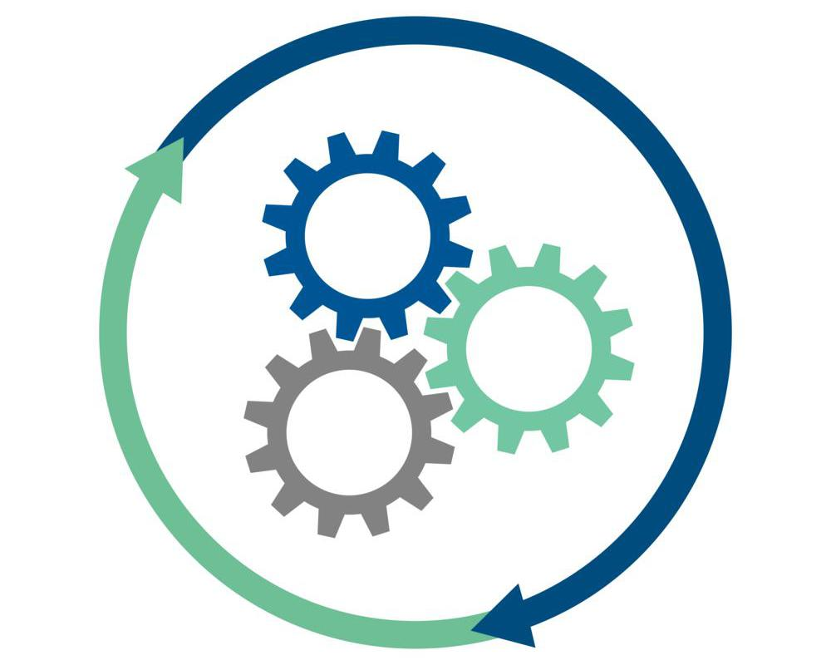
Understanding Lean Manufacturing
Lean manufacturing is a systematic method for minimizing waste within a manufacturing system while maximizing productivity.

Slide 4
Core Principles
Identify Value
Map the Value Stream
Create Flow
Establish Pull
Pursue Perfection

Slide 5

Seven Wastes
Overproduction
Inventory
Waiting
Transportation
Motion
Overprocessing
Defects

Slide 6
Tools and Techniques
5S System
Kanban System
Poka-Yoke (Error Proofing)
Kaizen (Continuous Improvement)
Value Stream Mapping

Slide 7
Benefits
Increased Efficiency
Cost Reduction
Improved Quality
Faster Time-to-Market
Enhanced Employee Morale
Sustainable Growth

Slide 8
Conclusion
Lean Manufacturing stands as a powerful framework, offering a strategic pathway to heightened efficiency, reduced costs, and improved quality in production processes. Lean Manufacturing is a mindset that propels organizations toward sustainable success and operational excellence.

